Slide 1

Intern Model Rocket TIM
Rocketry team led by Mateo Atwi
Technical Interchange Meeting
3/29/19

Slide 2
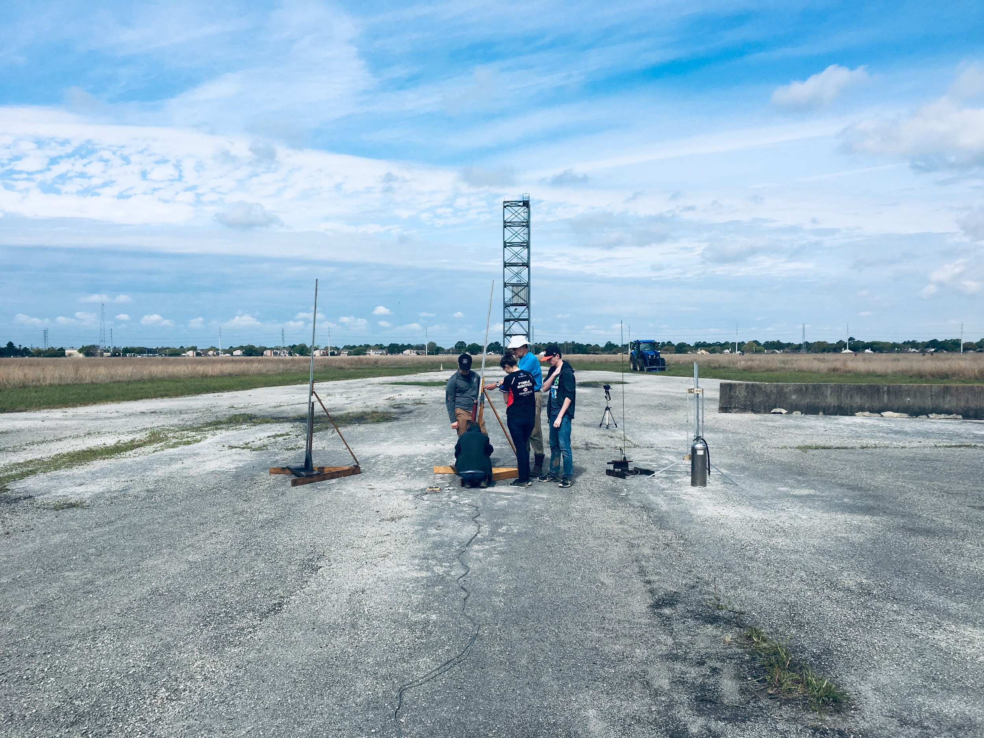

Slide 3
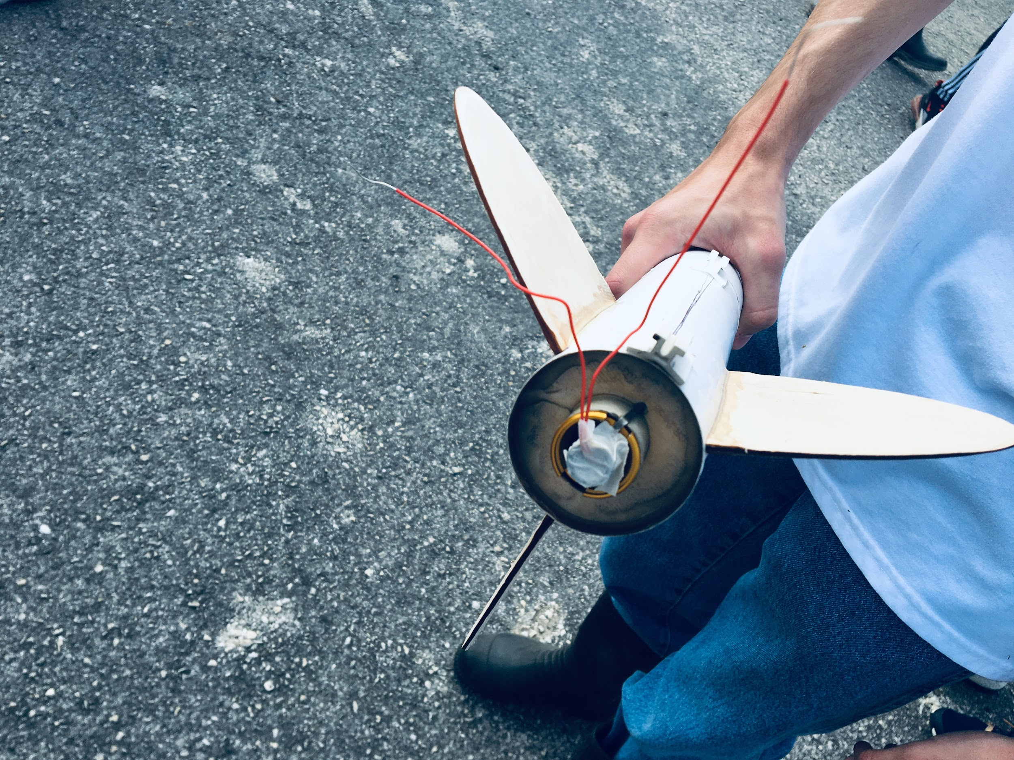

Slide 4
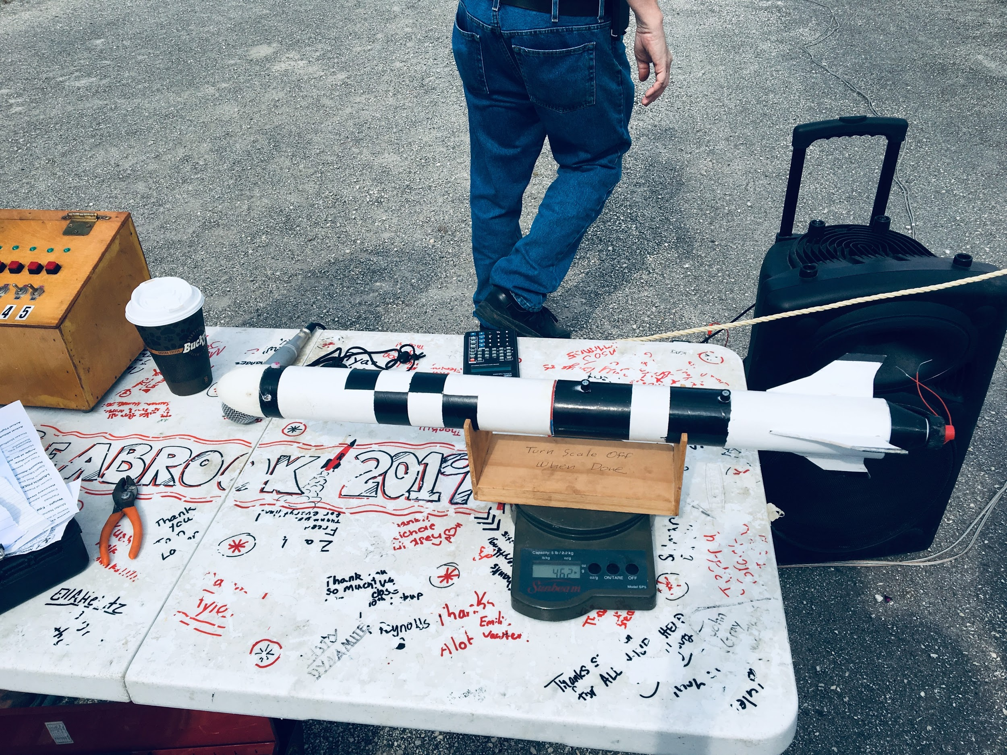

Slide 5
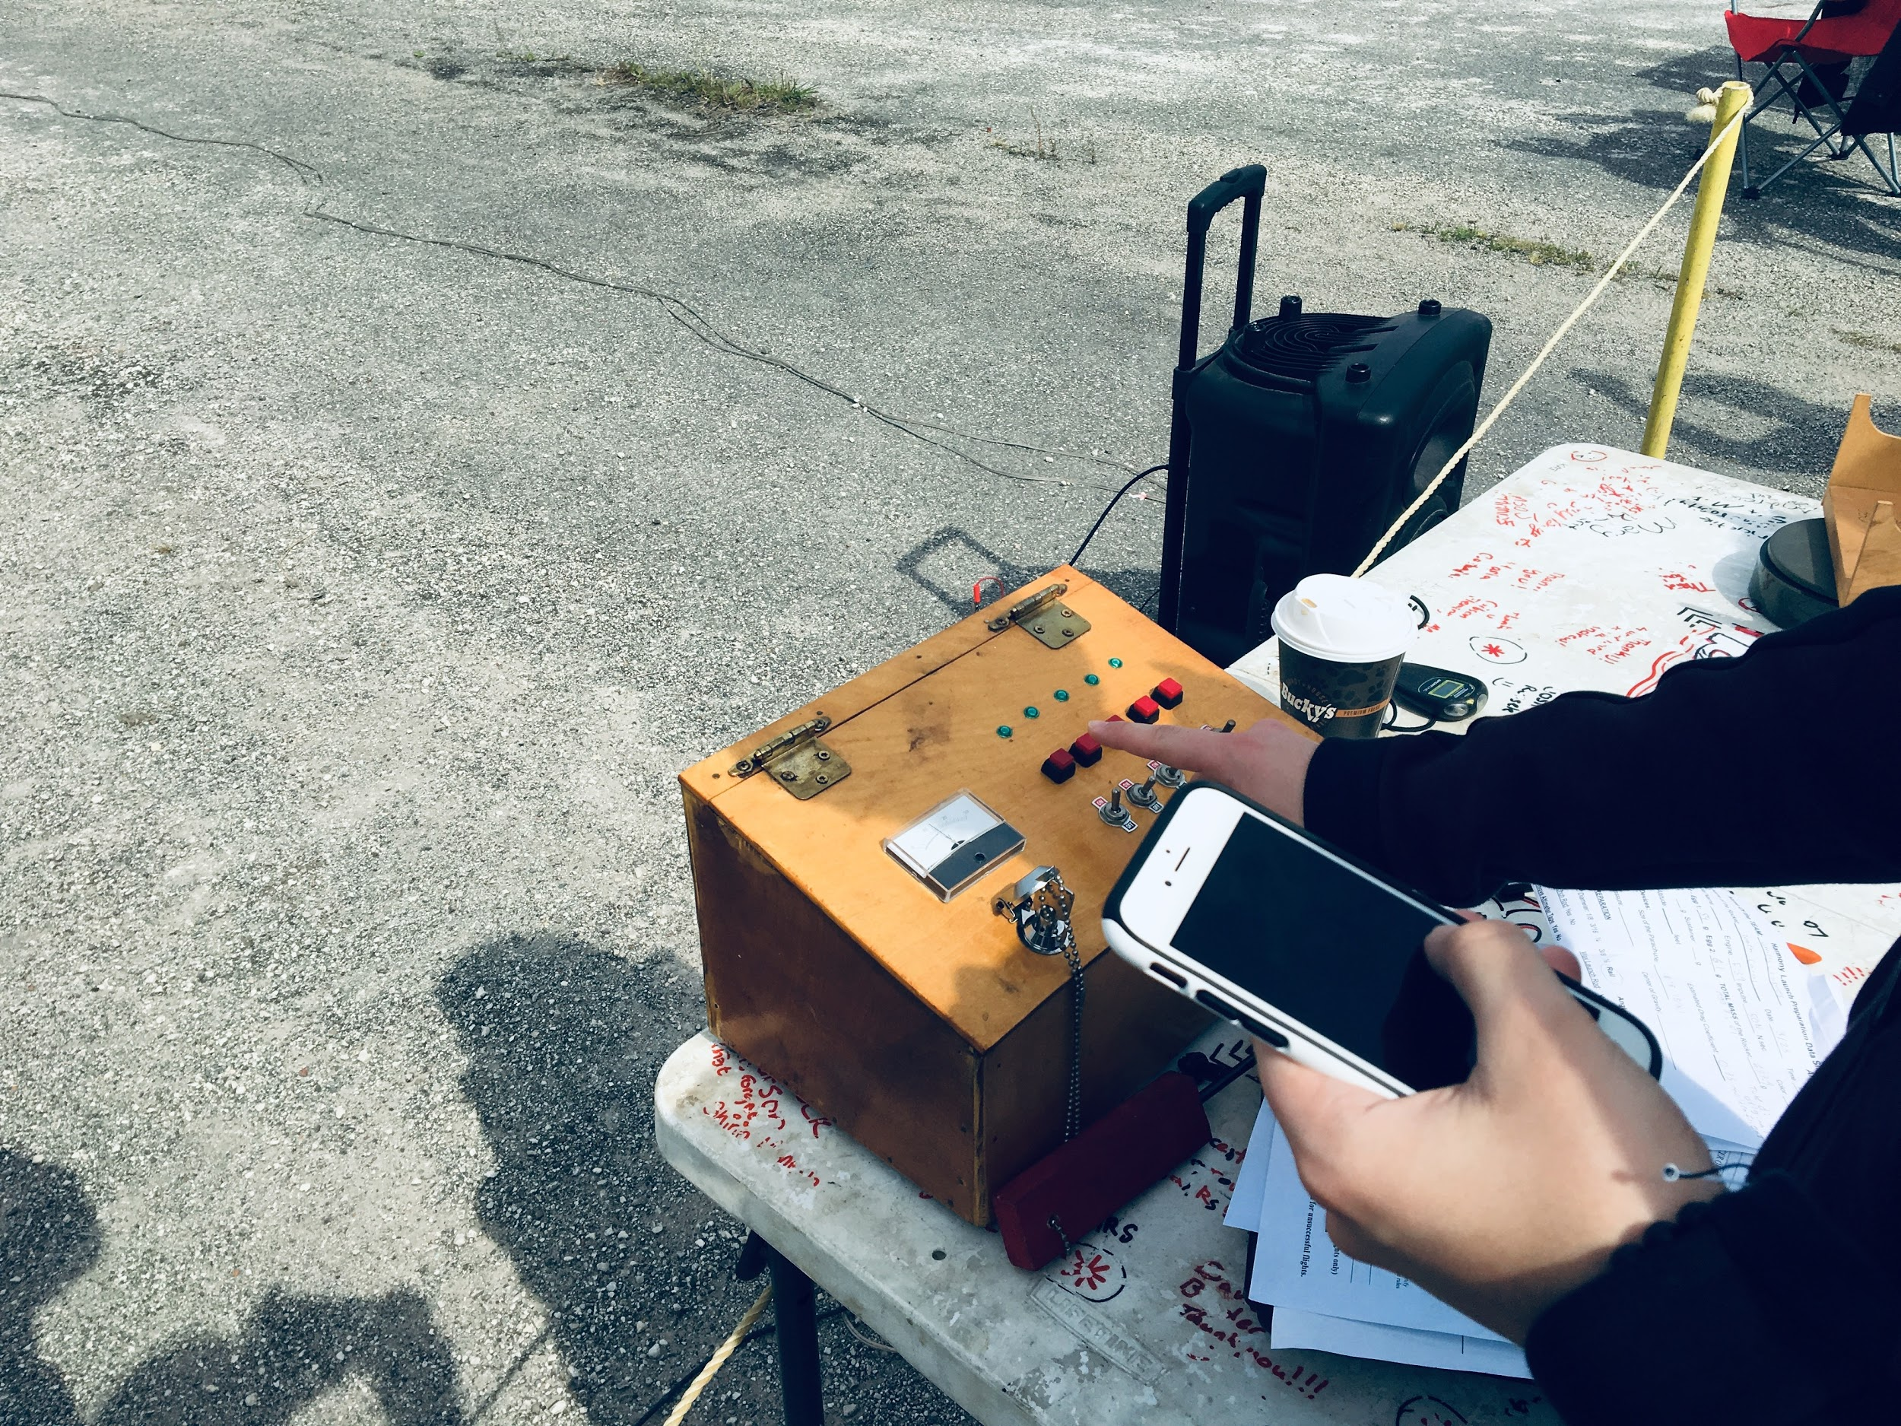

Slide 6
Meeting Agenda
Intro
Safety
Requirements
Schedule
Goals
High Level Rocket System Design
Airframe
Launch Systems
Recovery
Procurement and Funding
Propulsion
Avionics
Closing
Recognition
Open floor discussion
Notes:
Expected duration: 1 hours

Slide 7
Intro
Safety
Requirements
Schedule
Goals

Slide 8
Safety & Mission Assurance
Led by Mikaela Peters

Slide 9
Safety & Mission Assurance
Establishment of the Rocketry Committee
Began in Spring, 2018
This marks the fourth consecutive semester of the committee
First semester didn’t have a Safety & Mission Assurance component
Purpose of Safety & Mission Assurance Subsystem
To ensure launch day goes smoothly
To ensure rocket is built to launch-site standards
Mitigate safety risks in design and during launch
Provide equipment required for launch day, such as a fire extinguisher
Hold other subsystems accountable for working safely and finishing their tasks in a timely manner to ensure that the entire project is running on schedule
Subsystems
Division of labor
Promote team effort
Learning opportunities
Notes:
Model rocketry is designed to be low-risk
Because this is a concerted group effort, coordination is required. This is where Safety & Mission Assurance comes in.

Slide 10
Timeline
RCM 1 02/21/19 First Meeting
RCM 2 02/28/19 Initial Design Review
RCM 3 03/07/19 Second Design Review
RCM 4 03/14/19 Major Design Review
RCM 5 03/20/19 Tag-up Before Break
RCM 6 03/28/19 Presentation Prep (build week part 1)
RC TIM 03/29/19 Design Technical Interchange Meeting with Full Timers
RCM 7 04/04/19 System Integration (build week part 2)
RCM 8 04/11/19 All systems go (build week part 3)
RCM 9 04/20/19 Launch
RCM 10 04/25/19 Last meeting/Lessons learned/Party/Review

Slide 11
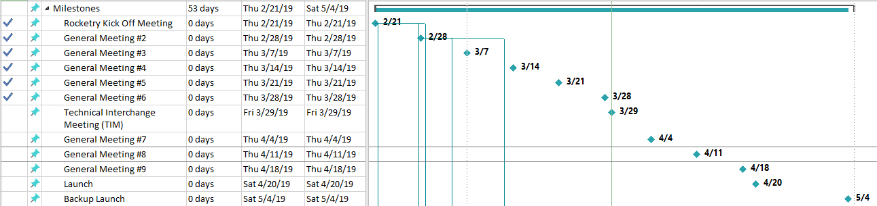
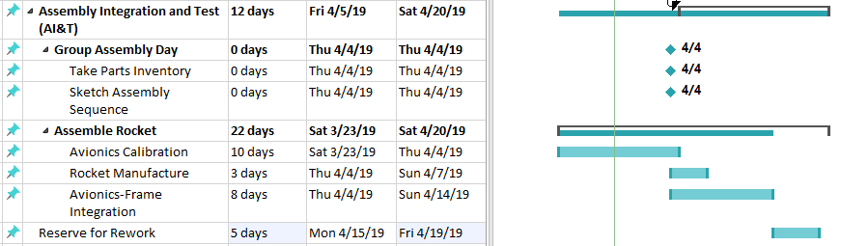
Schedule
Launch Date: Saturday, April 20th
Backup Launch Date: Saturday, May 4th
Two weeks margin
Parallel Tasks

Slide 12
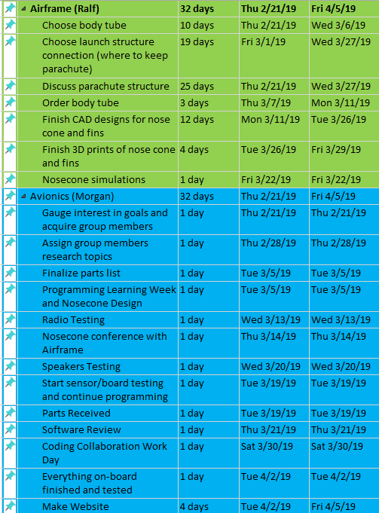
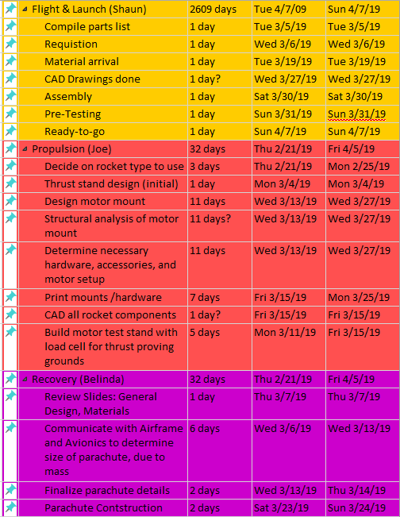
Collection of Individual Subsystem Tasks

Slide 13
Requirements

Slide 14
NAR Requirements
Materials. I will use only lightweight, non-metal parts for the nose, body, and fins of my rocket.
Motors. I will use only certified, commercially-made model rocket motors, and will not tamper with these motors or use them for any purposes except those recommended by the manufacturer.
Ignition System. I will launch my rockets with an electrical launch system and electrical motor igniters. My launch system will have a safety interlock in series with the launch switch, and will use a launch switch that returns to the “off” position when released.
Misfires. If my rocket does not launch when I press the button of my electrical launch system, I will remove the launcher’s safety interlock or disconnect its battery, and will wait 60 seconds after the last launch attempt before allowing anyone to approach the rocket.
Launch Safety. I will use a countdown before launch, and will ensure that everyone is paying attention and is a safe distance of at least 15 feet away when I launch rockets with D motors or smaller, and 30 feet when I launch larger rockets. If I am uncertain about the safety or stability of an untested rocket, I will check the stability before flight and will fly it only after warning spectators and clearing them away to a safe distance. When conducting a simultaneous launch of more than ten rockets I will observe a safe distance of 1.5 times the maximum expected altitude of any launched rocket.
https://www.nar.org/safety-information/model-rocket-safety-code/

Slide 15
NAR Requirements
Launcher. I will launch my rocket from a launch rod, tower, or rail that is pointed to within 30 degrees of the vertical to ensure that the rocket flies nearly straight up, and I will use a blast deflector to prevent the motor’s exhaust from hitting the ground. To prevent accidental eye injury, I will place launchers so that the end of the launch rod is above eye level or will cap the end of the rod when it is not in use.
Size. My model rocket will not weigh more than 1,500 grams (53 ounces) at liftoff and will not contain more than 125 grams (4.4 ounces) of propellant or 320 N-sec (71.9 pound-seconds) of total impulse.
Flight Safety. I will not launch my rocket at targets, into clouds, or near airplanes, and will not put any flammable or explosive payload in my rocket.
Launch Site. I will launch my rocket outdoors, in an open area at least as large as shown in the accompanying table, and in safe weather conditions with wind speeds no greater than 20 miles per hour. I will ensure that there is no dry grass close to the launch pad, and that the launch site does not present risk of grass fires.
Recovery System. I will use a recovery system such as a streamer or parachute in my rocket so that it returns safely and undamaged and can be flown again, and I will use only flame-resistant or fireproof recovery system wadding in my rocket.
Recovery Safety. I will not attempt to recover my rocket from power lines, tall trees, or other dangerous places.
https://www.nar.org/safety-information/model-rocket-safety-code/
Notes:
80.01–160.00 G 1,000 MOVE THIS TO THE PROPULSION SLIDES

Slide 16
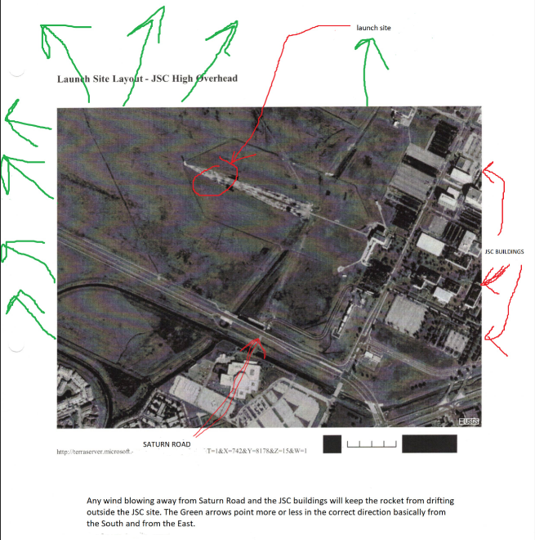
Lessons Learned
Involvement with Houston Rocket Club
South & East: Good
North & West: Bad
Build margin into schedule for launch window
Launch with Houston Rocket Club
Equipment
Expertise
POC: Ernest Srother - Range Safety Officer
Launch requirements
2000 ft limit
Insight into wind

Slide 17
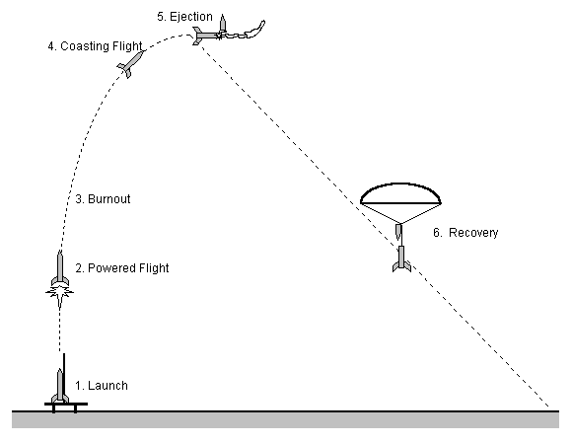
Launch Abort Limits
Abort Launch if winds are blowing in the following directions:
5 mph North and/or West (estimated horizontal travel distance of 625 ft)
15 mph South and/or East (estimated horizontal travel distance of 1875 ft)

Slide 18
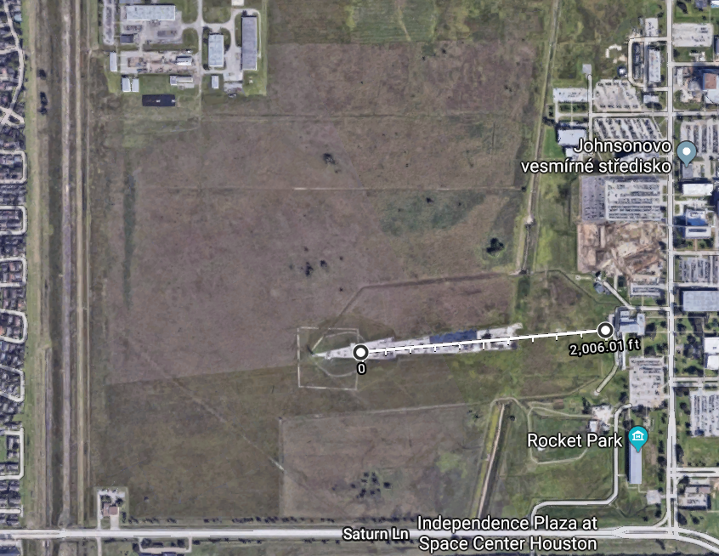
Launch Site
2000 ft
N
E
W
1000 ft
S
500 ft

Slide 19
Goals

Slide 20
Rocketry Committee Goals
Priorities
Have fun
Safely build and fly a rocket
Engage all participants

Slide 21
Rocket Goals
The largest model rocket possible
1 G class motor
Launch at JSC
(Max altitude of 2000 ft at less than 20 degrees)
Cannot land on road or by JSC buildings
Avionics payload
Creative and innovative
Notes:
Initially went with 2 G motors, but had to pair down.
Take about relaunchability

Slide 22
Overall System
Airframe
Recovery
Procurement and Funding
Propulsion
Launch System
Avionics

Slide 23
Airframe
Led by Rafael Gonzalez and Daniela Rocca Bejar
CAD Manager: Lee R. Cantu

Slide 24
Outline
Model Rocket Airframe Basics
Intern Model Rocket Airframe
Simulations and Results

Slide 25
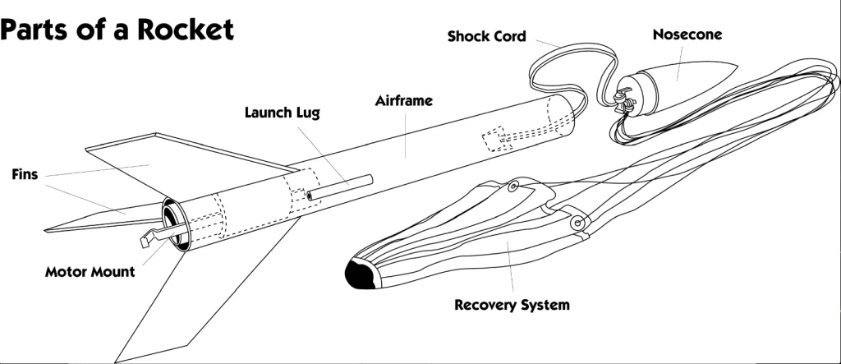
Basics for smaller rocket design

Slide 26
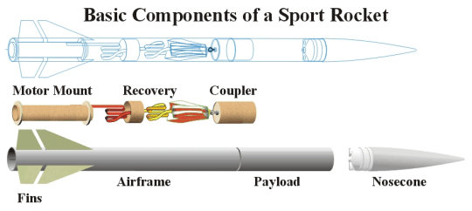
Basics for larger rocket design

Slide 27
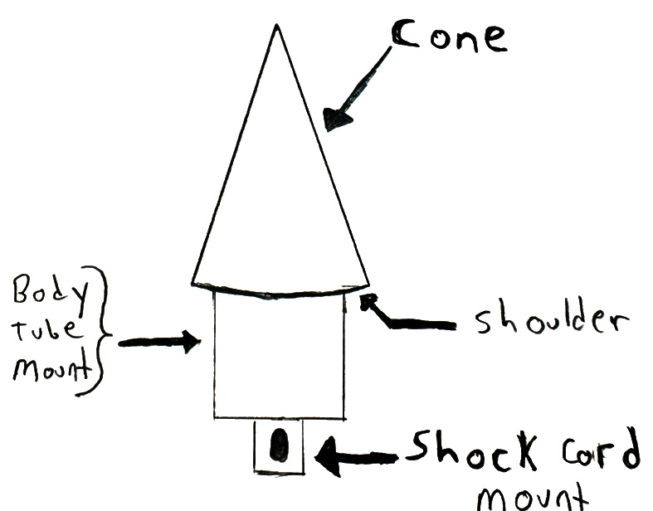
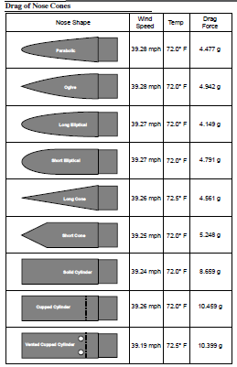
Nosecone
Needs to be heat resistant due to friction
(if flying at very high speeds )
Materials:
Molded plastic or wood (balsa, basswood)
For high end, fiberglass, carbon fiber, composites
Size constrained by diameter of body tube
In turn, determines size of payload
We can purchase (~ $15) or manufacture

Slide 28
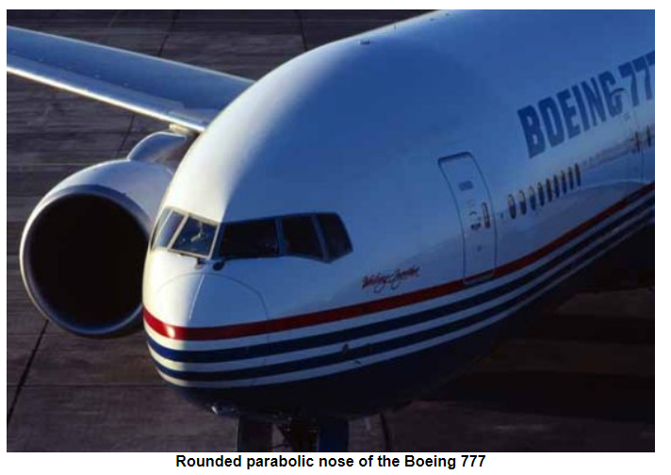
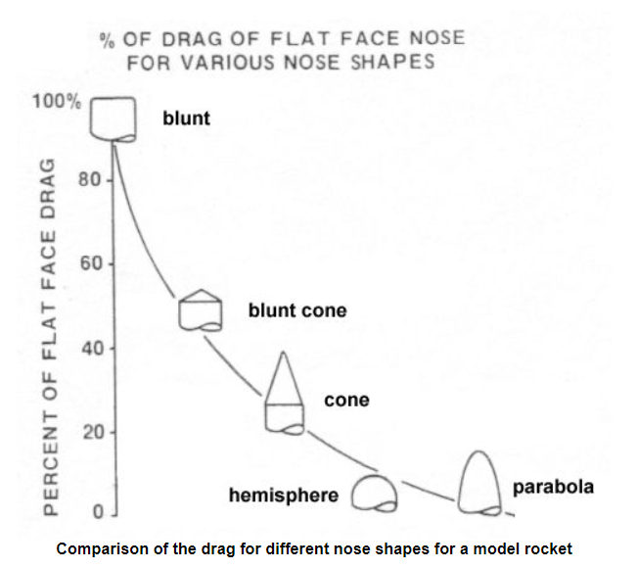
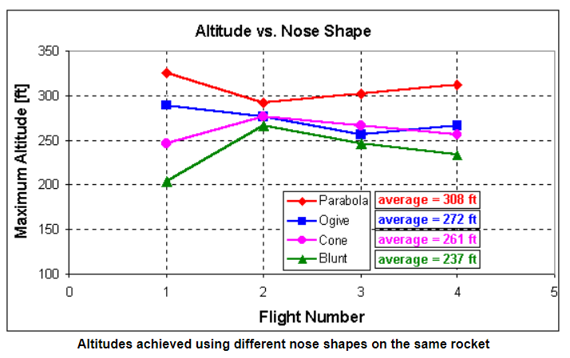
Nosecone
* Subsonic flight -> Rounded parabolic nose e.g Boeing 777
** You want the air to flow smoothly.
** Minimize drag and improve altitude
** Nosecone shape depends on motor selection.
Effect of Nose Cone Shape on Altitude (same motor and BT was used for each experiment).

Slide 29

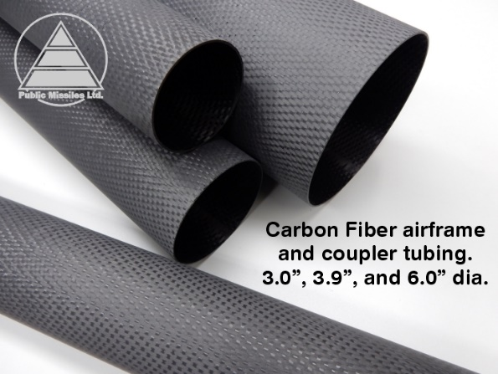
Airframe (Body Tube = BT)
Houses: Motor tube, centering rings, payload bay, parachute ejection mechanism and nose-cone. Motor retainer installed at the rear.
We could avoid using a motor retainer and centering rings if motor diameter fits perfectly the BT.
Materials
Rolled paper tubes common and cheap. Cost ~ $10 - $20 (BT only though!)
High end: paper, phenolic tubing (high-temp), plastic tubing, fiberglass, carbon fiber
Can be reinforced with epoxy or fiberglass ( adds weight)

Slide 30


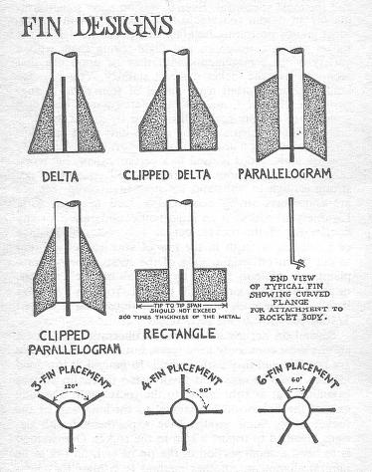
Fins
Provide stability and guidance, vertical orientation
Need to have a thin leading edge to reduce drag and chances of failure
Materials:
Balsa wood or basswood
G-10 (synthetic fiberglass/plastic composite)
To reduce weight, we can use foam or balsa then reinforce with thin hardwood, fiberglass, or epoxy. (Depending on the velocity of the rocket)
Fins securely adhering to airframe is critical

Slide 31
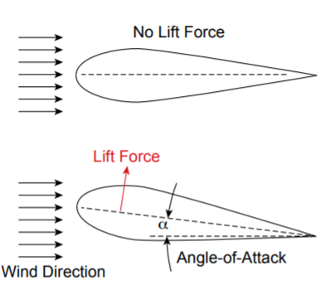
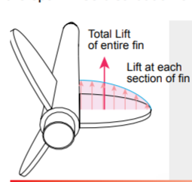
Fins
Provide stability and guidance, vertical orientation
Need to have a thin leading edge to reduce drag and chances of failure.
From rocket’s perspective

Slide 32
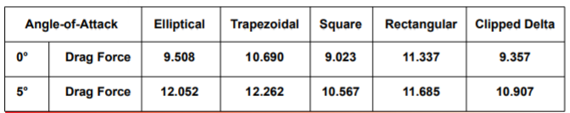
Fins
* For a rocket going up to 100 mph.

Slide 33
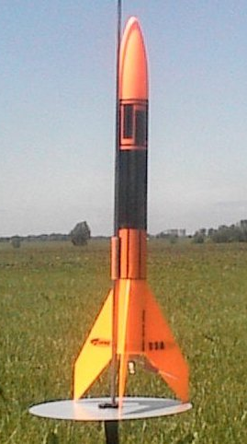
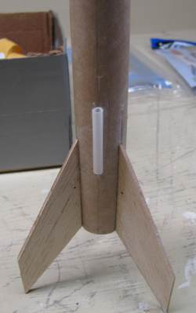
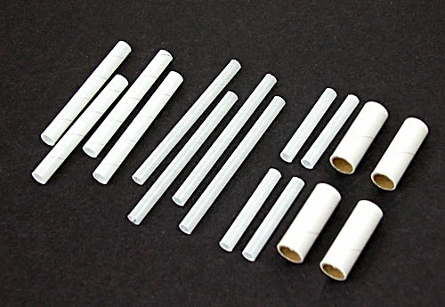
Launch Lug
Guide rocket along rod guide during start of flight
Range from about 1/8” to 1” diameter
Materials:
Rolled paper for paper airframes
Brass or aluminum for heavier rockets

Slide 34
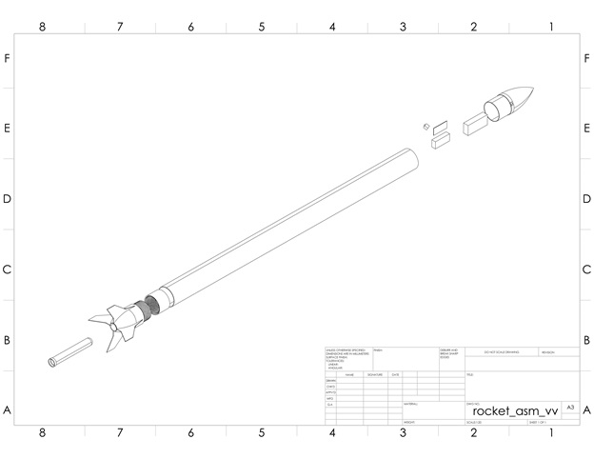
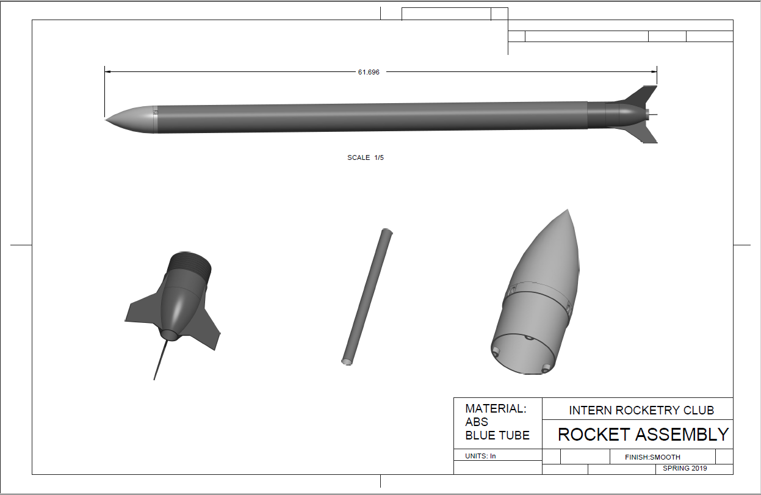
Now for our rocket!

Slide 35
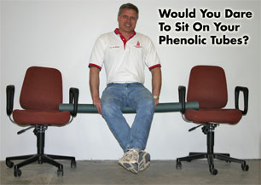
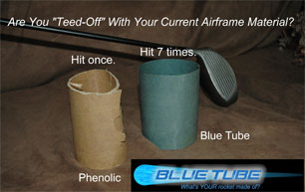
Blue Tube Body
High-strength, high-density, “shatterproof” paper tubes for model rocketry
Good, cheap alternative to carbon fiber reinforced or phenolic tubes
Almost as strong as phenolic tubes but much more shock resistant
Inner Diameter: 3.0 inch
Outer Diameter: 3.1 inch
Weight: Approx 12 oz per inch of length

Slide 36
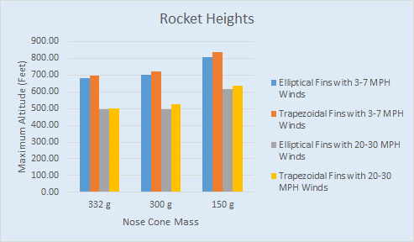
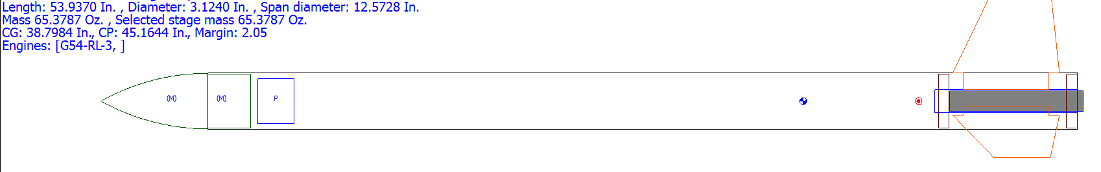
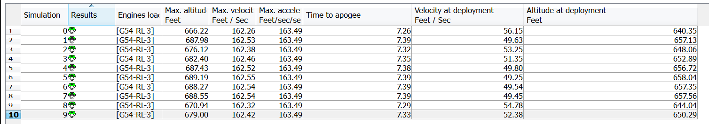
Fin Analysis Simulations
Preliminary simulations showed that there is not a significant difference between trapezoidal and elliptical fins
Future simulations will run with more accurate weight and dimensions for our rocket

Slide 37
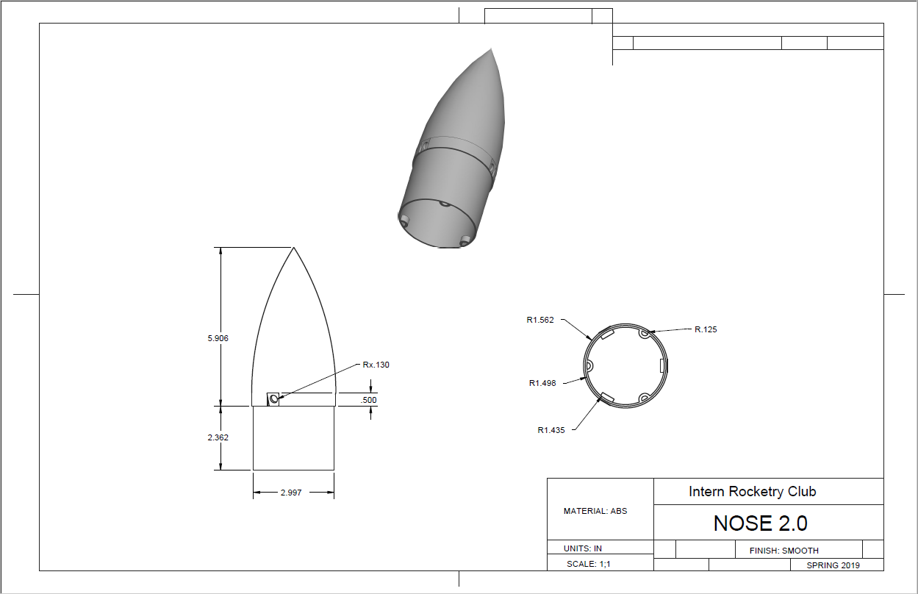
3-D Printed Nose Cone
Key challenge to integrate all avionics within the nose cone.
Notes:
ABS Glass transition temp - 105*C (221*F)
PLA Glass transition temp - 60*C (140*F)

Slide 38
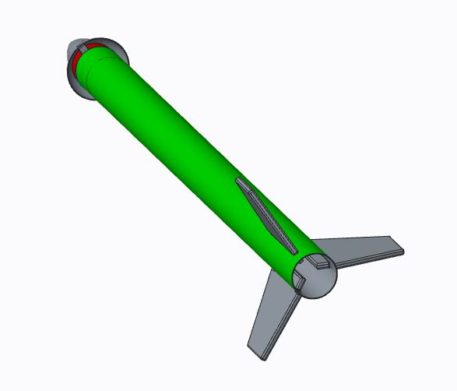
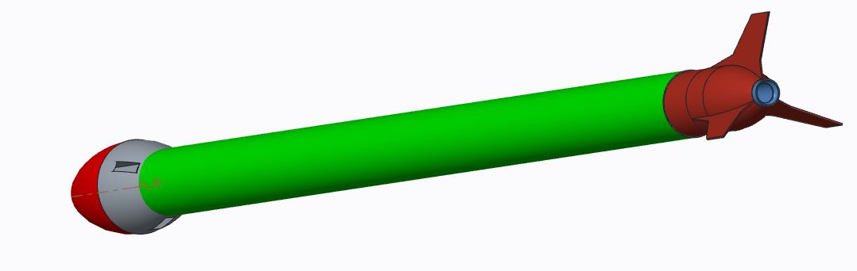
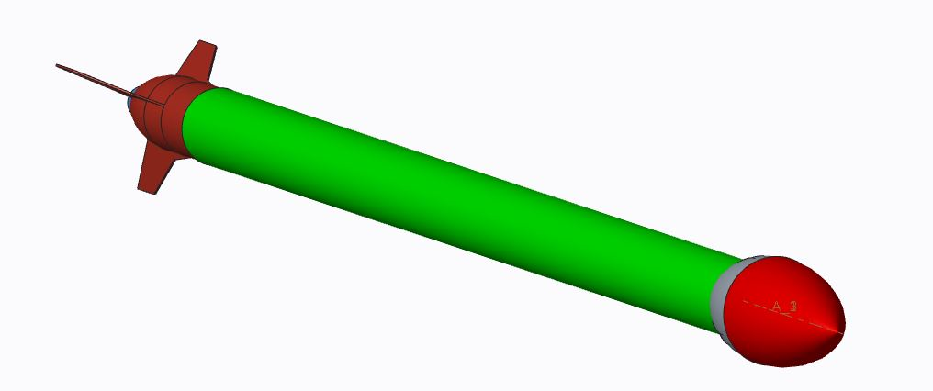
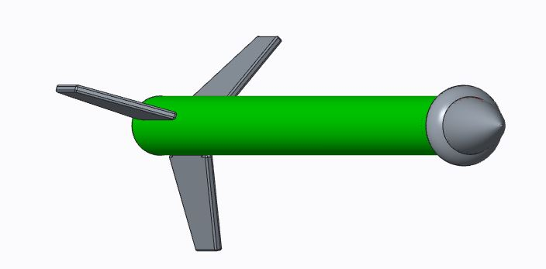
Initial Nose Cone Designs

Slide 39
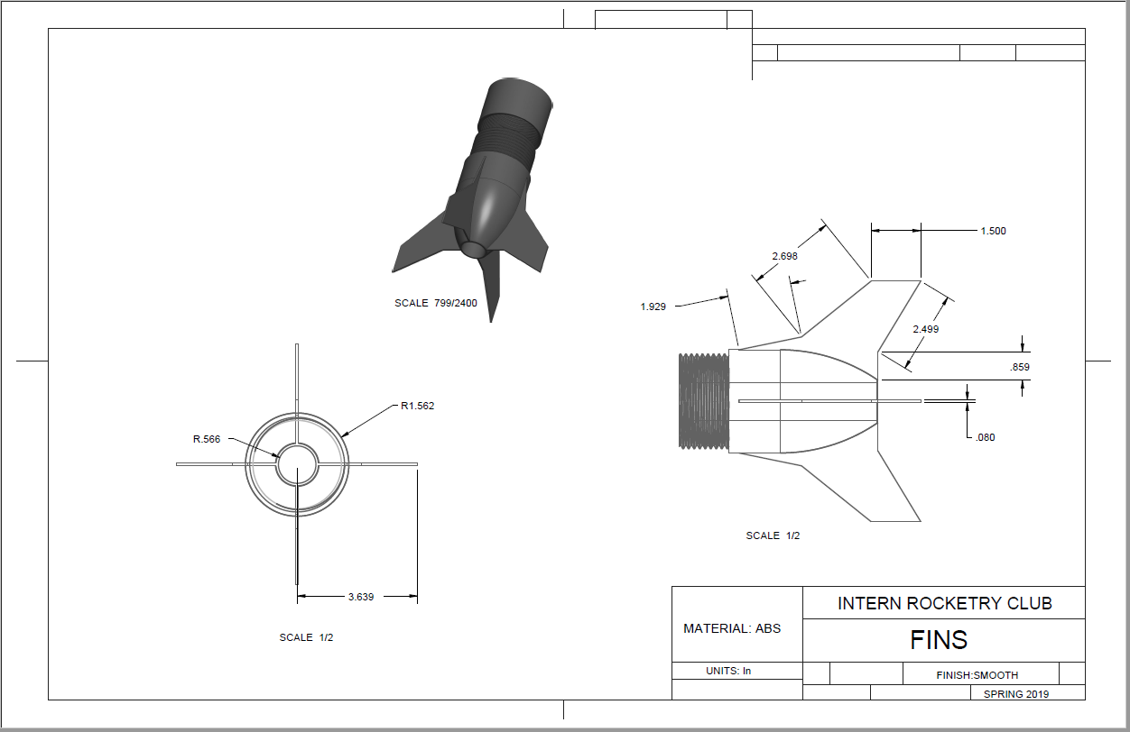
3-D Printed Fins
Design choice / challenge to create a modular, replaceable fin set to be integrated with the thrust mount
Notes:
Initiator Kit

Slide 40
ROCKET STABILITY

Slide 41
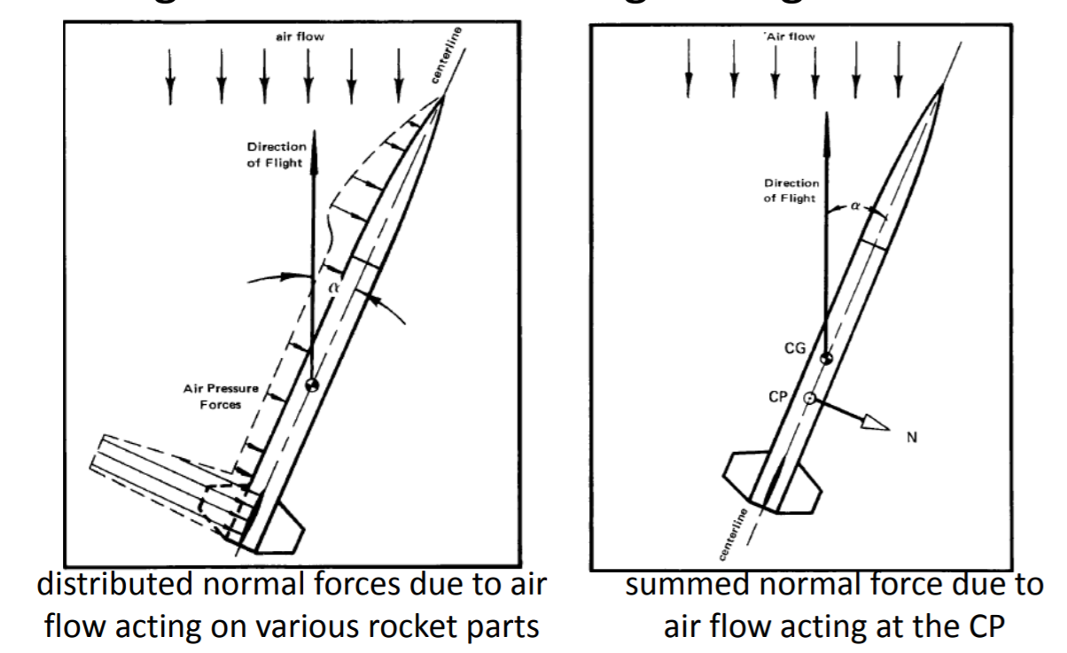
Static Margin
CG vs Cp distance: 1 caliper = 1 body tube rocket diameter (Neutral Stability)
Caliper(s) also known as ‘units of largest body diameter’
Aerodynamic forces self-correct
the rockets direction.

Slide 42
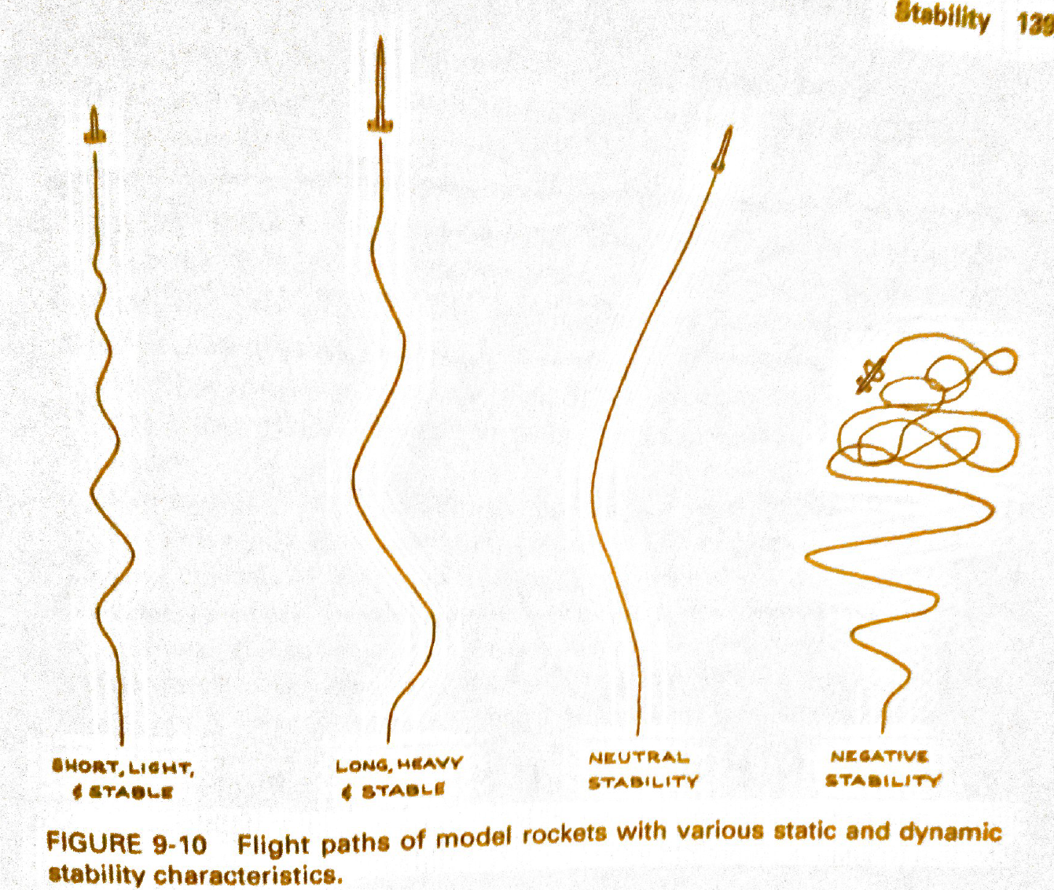
~1 – 1.5 calipers
~2 calipers
~2 calipers

Slide 43
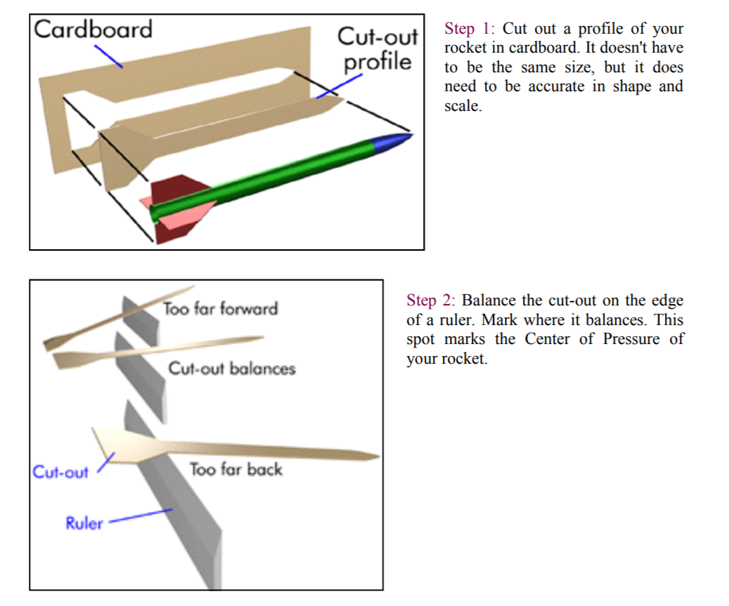
Course of Action:
1) Experimentally measure CG and Cp positions:
Cp Measurement
* 3D to 2D because rocket is symmetrical.

Slide 44
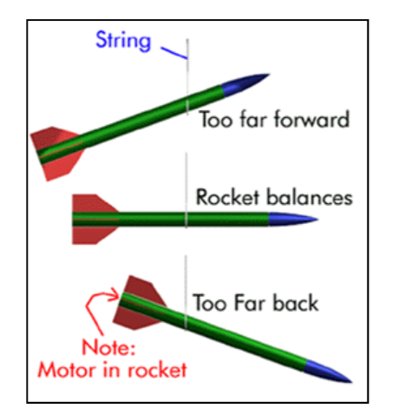
Course of Action:
- Experimentally measure Cg and Cp positions:
Cg Measurement
* Balance your rocket (from definition of Cg)

Slide 45
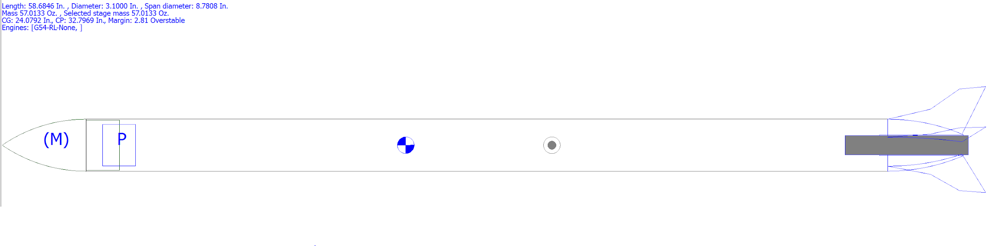
Course of Action:
2) Rocksim and OpenRocket Simulations (after measuring the weight of each rocket component).
Preliminary Rocksim Cg and Cp calculation with approximated
component weights.

Slide 46
Recovery
Led by Amanda Graziosi

Slide 47
Objectives
General
Responsibly design and execute recovery system
given limited resources
Create opportunity to learn about non-business perspective
non STEM majors opportunities
creating rather than purchasing
Design Specific Requirements
Drift Distance < 2000 ft
Airframe Ground Impact Velocity < 25 ft/s

Slide 48
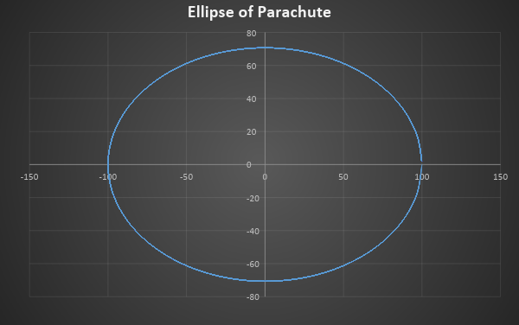
Shape
Semi-ellipsoid
More efficient than a hemispherical design
Greater drag force for a given canopy surface area
Descent Rate: 11.73 ft/sec ft/sec
40 in Diameter, but shown as 100 cm Diameter

Slide 49
Materials
Canopy: Soar Coat Fabric
Zero Porosity Silicone Coated Nylon
Strength: 45x45 lb/in
Total Weight: 4.46 oz
Melts at 450° F, but has a heat resistant coating
Shroud Lines: Polyester Twine
Dimension: 0.033 in. diameter
Strength: 50 lb minimum breaking strength
Length: 40 in (less issues with lines tangling)
Quantity: 12 lines
Shock Cord: Nylon Webbing
0.5 in wide
Less flammable than your basic elastics
Non-stretch cord will absorb energy of release better than elastic

Slide 50
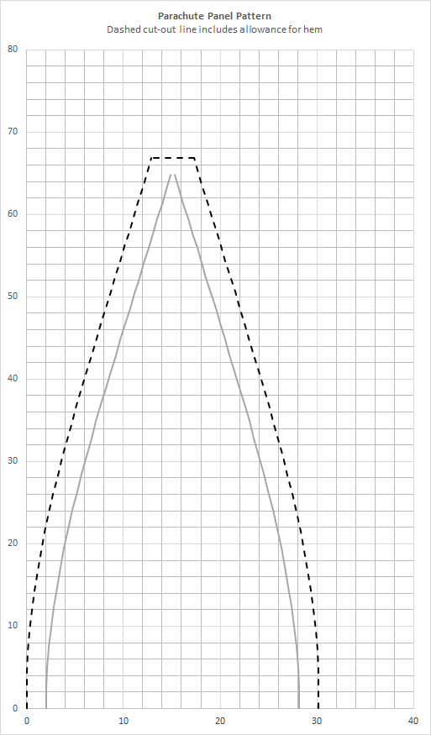
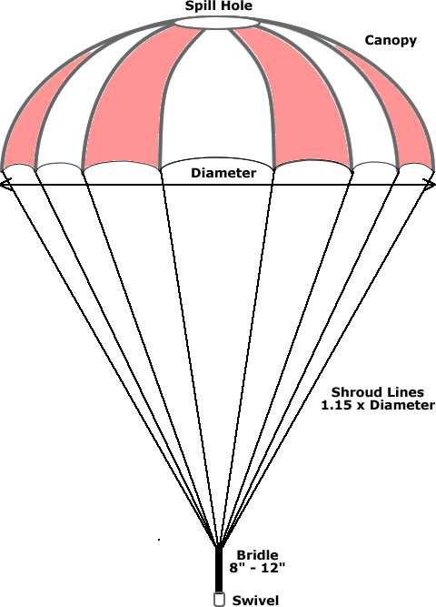
Parachute Construction
Shape: Semi-Ellipsoid
Diameter = 40 in
Number of Gores = 12 gores
Dimensions of Spill Hole: 4 in, which is 10% of the diameter of the chute
Gore Design

Slide 51
Safety Considerations
General
We will not attempt to recover from power lines, tall trees, or other dangerous areas.
Launch Site Envrionment
Outdoors
Safe Weather Conditions
Wind Speeds < 20 mph
Avoid dry, grassy areas

Slide 52
Procurement and Funding
Led by Reed Villarreal

Slide 53

Procurement/Funding
Developed working spreadsheet housing data for materials, including…
Price calculations
Weight measurements
Function of materials
Delivery/payment statuses
Total cost: $383
Used this to calculate accurate dues amounts for project members
Plan for remaining costs to cover ($250)
Fundraiser - designed and purchased 100 stickers and will be sold as follows
1 sticker = $3
2 stickers = $5
Sourcing reliability - Amazon is the most practical for this club
Notes:
For the process to obtain and track our materials

Slide 54
Propulsion
Led by Joseph Amar

Slide 55
Objectives:
IGNITION -- to safely ignite rocket engine
ALTITUDE -- to propel the rocket as high as possible, without exceeding flight ceiling
EJECTION -- to impart ejection charge at apogee
RETENTION -- to retain engine and mounting system within the rocket body at all times

Slide 56
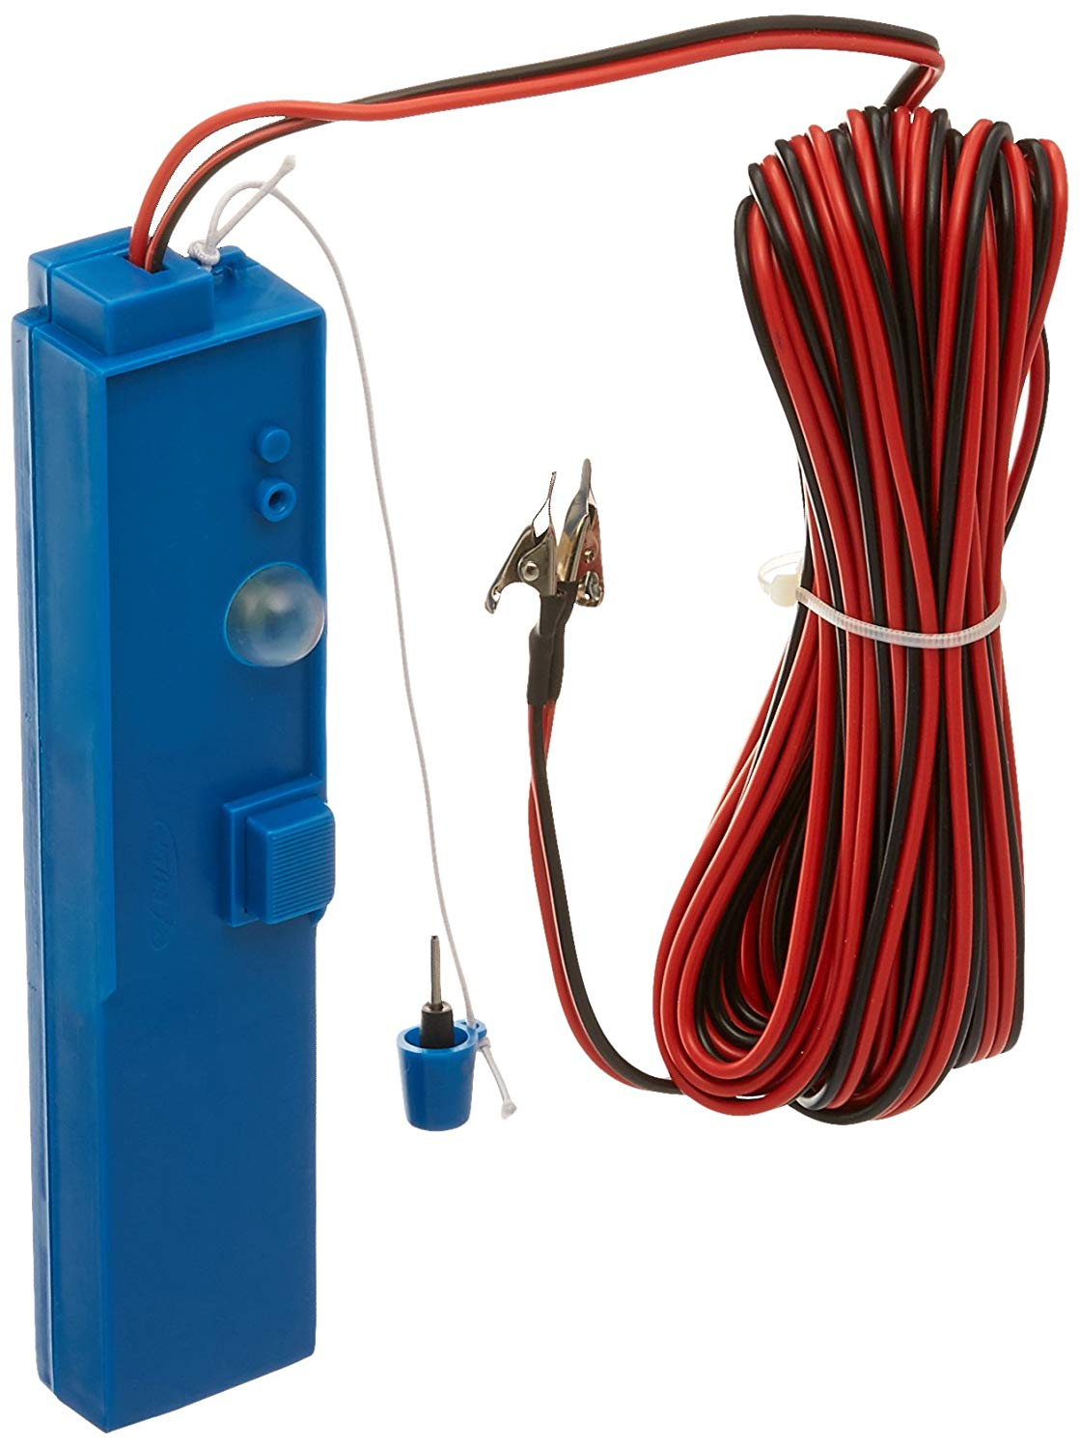
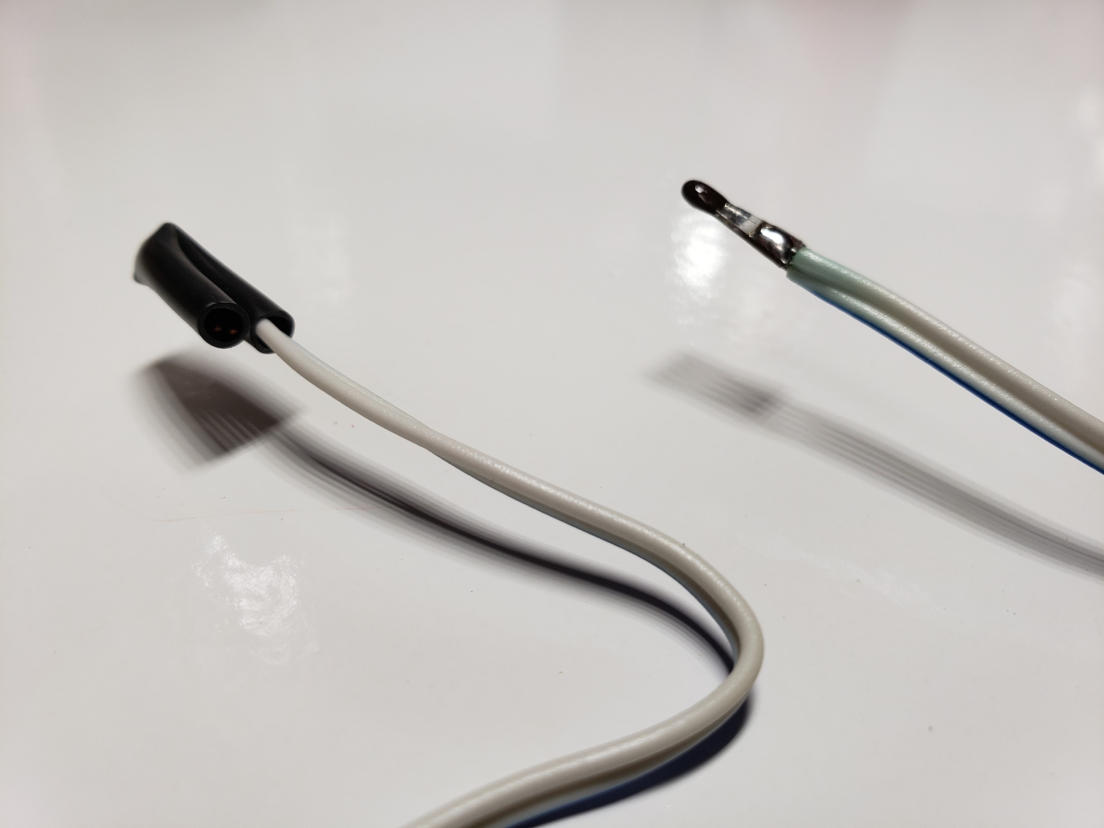
IGNITION
Will be using Commercial Off-the-Shelf (COTS) ignition system, powered by (4) AA batteries

Slide 57
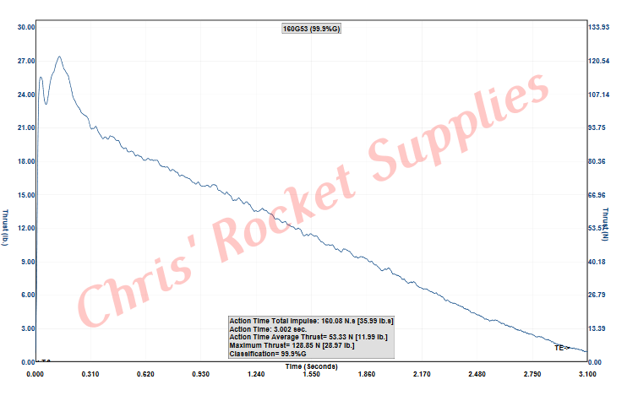

ALTITUDE
Limited to 2000 ft at JSC
We are also legally limited to a total impulse < 36 lb-s
Average Thrust

Slide 58
Impulse = Thrust_{avg} x time
The Cesaroni G54 has an average thrust of 12.1 lbf, and time from ignition-to-burnout is 2.97 s
Total Impulse = 35.94 lb-s

Slide 59

EJECTION
Each engine comes equipped with an ejection charge at the tip (forward end)
The ejection charge delay begins burning at MECO, in order to allow rocket to reach apogee prior to parachute deployment
Delay is adjusted with Pro-DAT Tool

Slide 60

RETENTION

Slide 61



Slide 62


Thrust is transferred into rocket body, NOT threads

Slide 63


Slide 64
Flight and Launch Operations
Led by Shaun Quinn

Slide 65
F&L OPS
Topics:
Goals
Design Considerations
Safety Considerations

Slide 66
F&L OPS: Goals
Design & Build Launch Controller
Develop Launch Procedure
Operate Launch Procedure

Slide 67
F&L OPS: Design Considerations
Typical Launch Controller
Low Functionality
Low Safety
Low Build Quality

Slide 68

F&L OPS: Design Considerations
Proposed Launch Controller
Advanced Functionality
Advanced Safety
Advanced Build Quality

Slide 69
F&L OPS: Design Considerations
Functions:
Countdown Timer
LED Indicators for Switches
Toggle Switches
Master Launch Button
Telemetry Read Outs

Slide 70

F&L OPS: Design Considerations
Preliminary Controller
Block Diagram
S1: Power on Pi
S2: Telemetry D1-D3 On
S3: Terminal Connect
S4: Countdown Timer D4 On
S5: Launch Button Armed

Slide 71
F&L OPS: Design Considerations
Controller Considerations:
Add Key-Locking Switch in Main Button Circuit
Add Inline Voltmeter with Test Voltage
Incorporate Voltage Testing in Procedures in Mean Time
Incorporate Terminal Disconnect into Launch Procedure

Slide 72

F&L OPS: Design Considerations
Proposed Operation Procedures:
Launch Day Systems Checks
Mission Control Set Up
Wireless Communications for Site Personnel

Slide 73
F&L OPS: Safety Considerations
Launch Day Procedure Setup:
Procedure Practice Runs
Failure Contingency Charts
Go/No-Go Check Lists
Intersystems Wireless Comm. Systems
Communication Hierarchy

Slide 74
F&L OPS: Safety Considerations
Goals:
NAR Controller Compliance
NAR Launch Compliance
Launch cleared by RSO (range safety officer)
Proofs:
Prescribed Designs with Testing
Launch Procedures to Exceed Standards
Launch Procedures Reviewed with RSO

Slide 75
Avionics
Led by Morgan Novak

Slide 76
Objectives:
Receive telemetry data from the rocket during launch
Stream video of rocket
Display data in an interesting way
Optional: Play sound from speakers at lift off and touchdown
Use LoRa to send sensor data from rocket to ground.
Sensors:
Barometer*
Altimeter*
Temperature*
Accelerometer
*all in one chip
Use FPV Drone Camera/Transmitter Package to send video from rocket to ground.
Display data from sensors and live video on monitor.
Port sensor data into launch control box.
Host website on Groundpi.
Backup: Firefly Camera that saves to SD card
Notes:
Morgan

Slide 77

*Monitor not shown
Notes:
Morgan

Slide 78




Sensors
RockPi
Barometer+Temperature+Altitude
Adafruit BMP280
SPI or I2C
Altitude based on pressure @ sea level (<10m)
Accelerometer
Adafruit MMA8451
I2C
Auto-tilt orientation detection
14 bit ADC
GND
SDA
GND
SDA
5V
3.3V
SCL
GND
SCL
Notes:
Morgan

Slide 79




LoRa
RockPi + GroundPi
Radio GPIO
Antenna
Used to send sensor data from RockPi to GroundPi
SPI
Sends/receives packets over 2km
Range Testing on B14 Antenna Range
~1,874 ft
5V
GND
CLK
MISO
MOSI
CS
RST
G0
Notes:
Kathryn

Slide 80



FPV Camera + Transmitter
RockPi
600TVL 1/4 1.8mm CMOS FPV 170 Degree Wide Angle Camera
PAL/NTSC
3.7-5V
Eachine VTX02 Super Mini 5.8G 40CH 200mW FPV Transmitter
No audio
3.3V
Camera Transmitter
Transmitter Pi
POWER ONLY
Notes:
Kolten

Slide 81


FPV Receiver
GroundPi
Eachine ROTG01 UVC OTG 5.8G 150CH Full Channel FPV Receiver
Range: 1476.38ft
Plugs into PC
Range: 3280.84ft
*Ranges are as advertised, did not have time to test
Notes:
Kolten

Slide 82


Displays
GroundPi
Website
Hosted by Ground PC
Screen capture of live display on monitor
Launch Control Box
7-segment displays for Altitude, Barometer, Accelerometer
Notes:
Elliot

Slide 83

RockPi
Pi Zero
Notes:
MDT

Slide 84

Power
Anker Astro E1 Battery
Capacity: 5200 mAh / 19.24 Wh
Output: 5 V / 2 A
Weight: 119 g / 4.2 oz
Size: 3.8 x 1.7 x 0.9 in
Notes:
MDT

Slide 85
Closing
Thanks
Open Floor Discussion

Slide 86
Thanks

Slide 87
Thanks to:
Ricky Villarreal, Bruce Manners, Darlyn Peddie
Intern Rocketry Committee leads, members, and members that did not present.
All TIM participants

Slide 88
Open Floor Discussion

Slide 89
Discussion Questions
Is this something we should continue?
Any ideas for future design TIMs and things like this?

Slide 90
End Presentation

Slide 91
Backup Slides

Slide 92
Schedule and Structure

Slide 93
Next Meeting 02/28/19 RCM 2
Meeting 03/07/19 RCM 3
Airframe + Avionics + Propulsion: body size, parts to purchase, motor
Propulsion: motor testing/building plans
Establish budget and collect dues
Order electronics parts/body/motors
Flight and Launch Operations + Airframe: launch structure + connection
Recovery + Airframe + Avionics: parachute
Safety and Mission: Review of necessary tasks
Order/purchase launch pad parts and recovery parts

Slide 94
Meeting 03/14/19 RCM 4
Meeting 03/21/19 RCM 5
Flight and Launch Operations + Propulsion: pad ignition system + electronics
Airframe + Avionics: nose cone design
Airframe: fin design
Propulsion: centering and thrust rings design and testing status update
Order/purchase parts and manufacture nose cone/thrust rings
Avionics: software review
Build day!

Slide 95
Org Chart
Airframe
Avionics & Payload
Launch & Flight
Propulsion
Safety & Mission
Recovery
Misc
Procurement
Lead
Rafael Gonzalez
Lead
Morgan Novak
Lead
Shaun Quinn
VP and Lead
Joe Amar
Lead
Mikaela Peters
Lead
Amanda Graziosi
Lead
Alex Kafer
Lead
Reed Villarreal
Lead & Analyst
Daniela Rocca Behar
Testing & Development
Kathryn Robertson
Analyst
Mitchell Gosma
Analyst
Mark Daniel Tredway
Integration Analyst
Michael Boazzo
Lead
Belinda Chang
CAD Manager
Lee Cantu
Web-dev
Elliot Briant
Analyst
Mark Daniel Tredway
Team Lead & POC
Mateo Atwi

